Slide 1
RASD – Travlendar+
Daverio Pietro, Fiorillo Alessandro

Slide 2
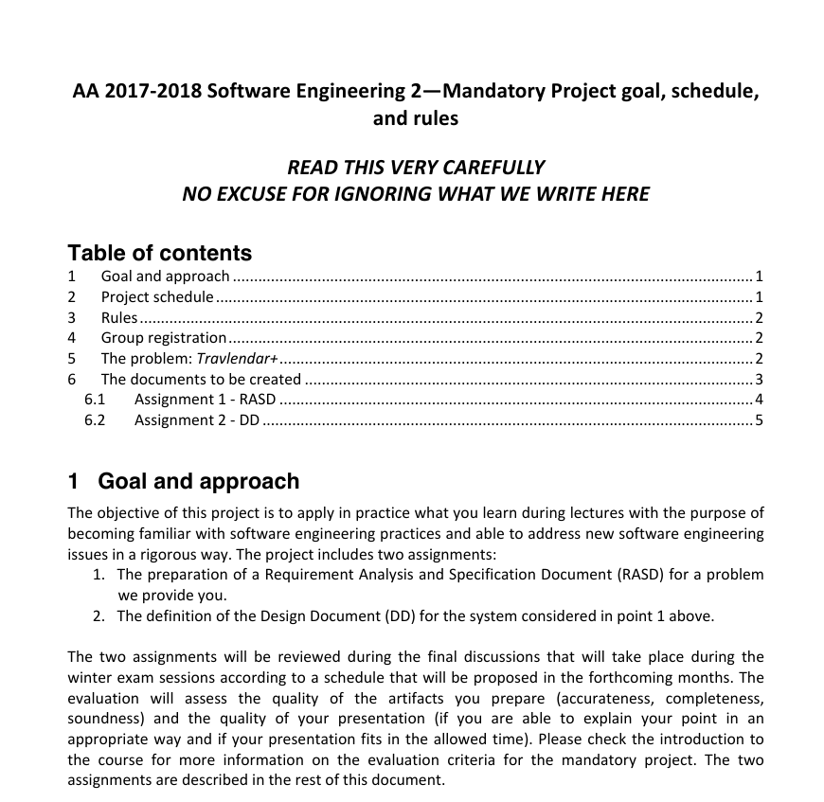

Guidelines

Slide 3

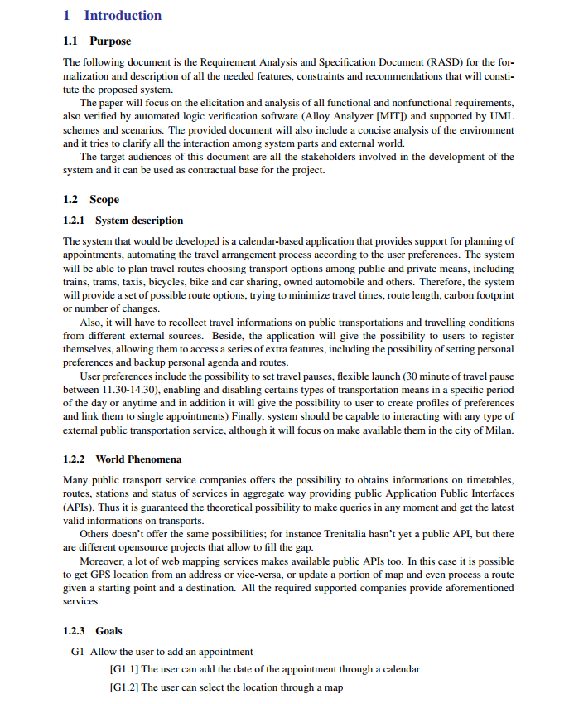


Introduction
1.3 Definitions, Acronyms, Abbreviations
1.4 Revision history
1.5 References
1.6 Document Structure

Slide 4
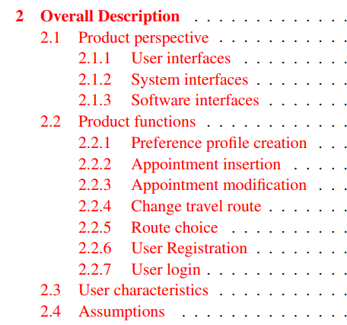


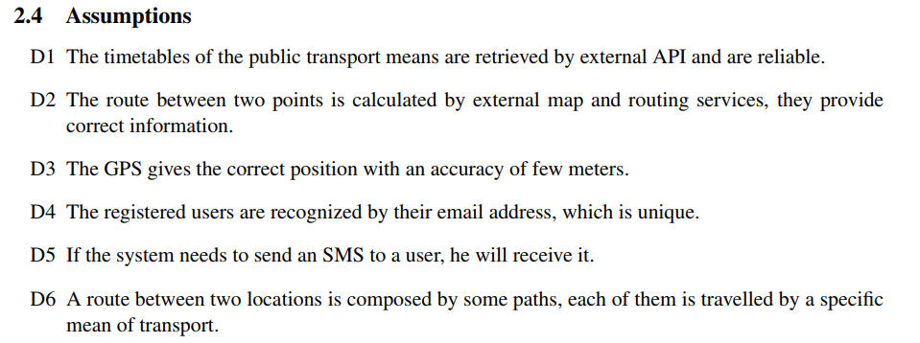
Overall Description

Slide 5
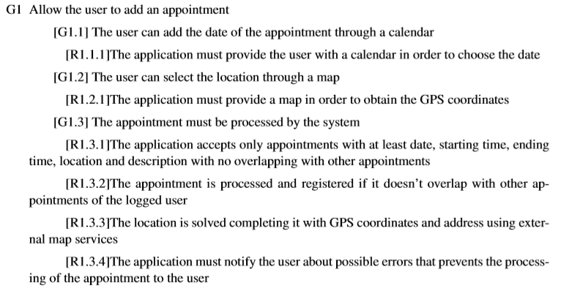
Functional Requirements - Appointments

Slide 6
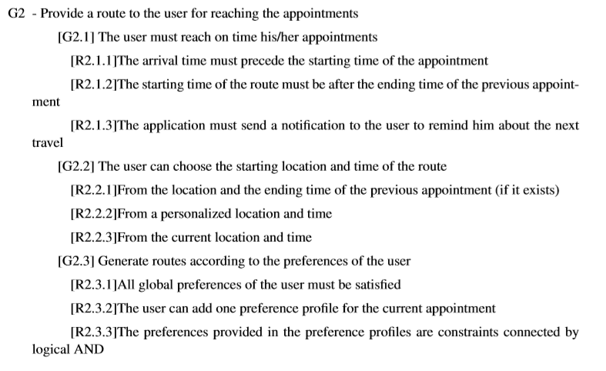
Functional Requirements - Routes

Slide 7
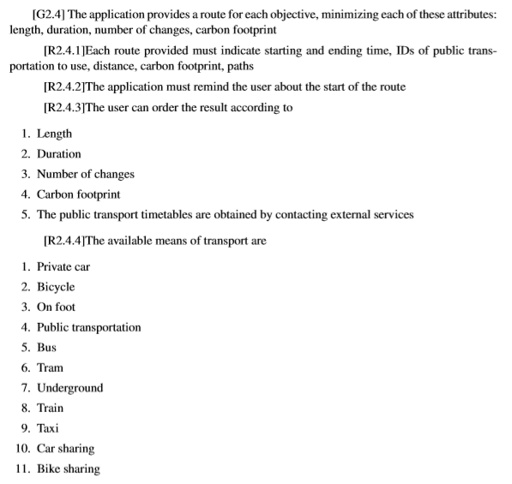
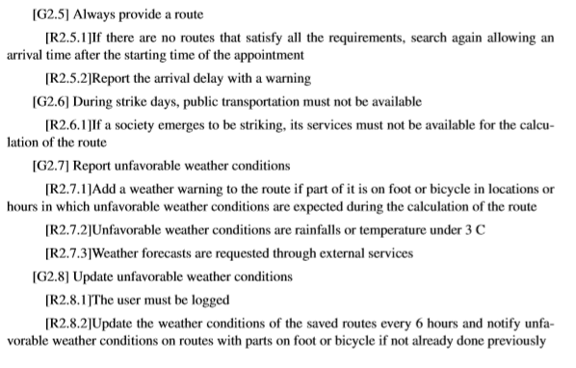
Functional Requirements - Routes

Slide 8
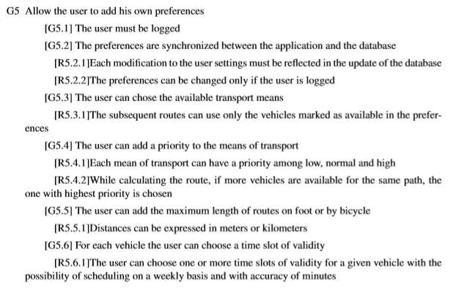
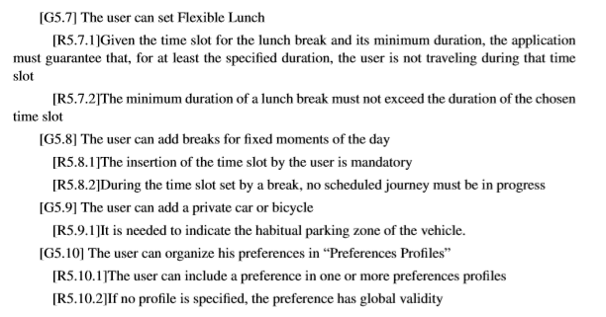
Functional Requirements - Preferences

Slide 9

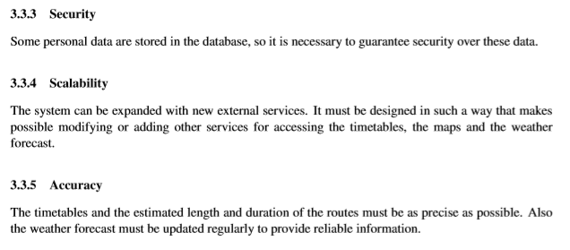
Non Functional Requirements

Slide 10
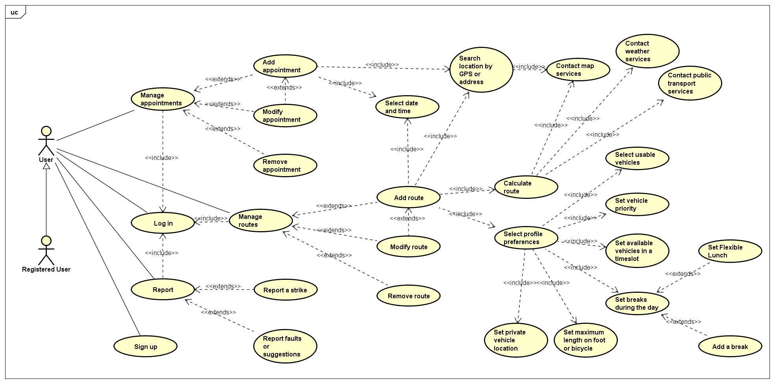
Use Case Diagram

Slide 11
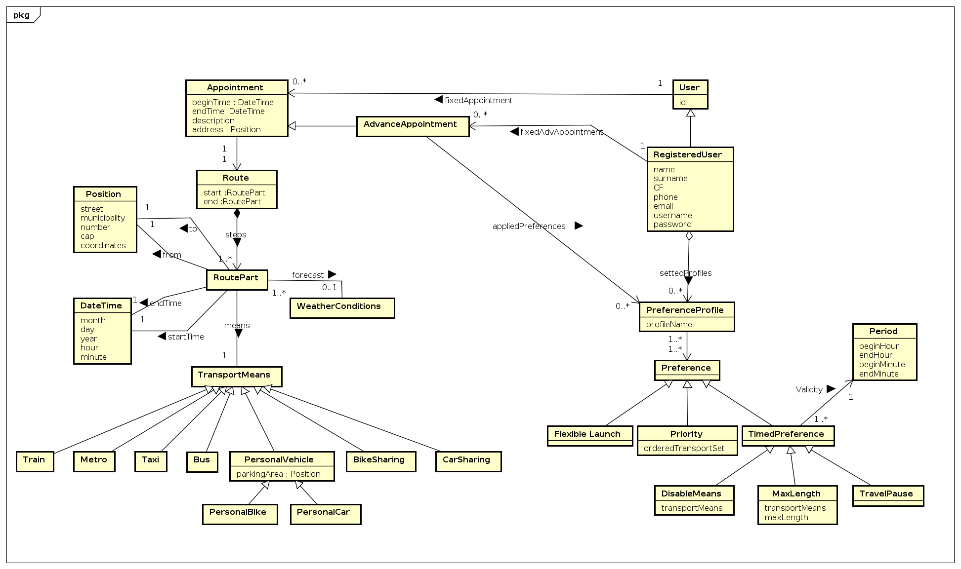

Slide 12
